Slide 1


Technical Design Thinking II
Spring 2025
Course Introduction
Project Overview
Dr. Bruce McFall

Slide 2
My Background
Professional
Automotive, Aerospace, Defense
(GM, GE Aviation, Wright Patterson AFB, Consultant)
Industrial Controls, Electric Motors, Radar Systems, Electronic Warfare, Jet Engine Modeling, Test Rig Design, Engine Control Software, Structural Design, Carbon Fiber Composites, Electric Vehicle Design
Academic
Ph.D. Integrated Systems Engineering – Ohio State University
M.S. Integrated Systems Engineering – Ohio State University
M.S. Mechanical Engineering – Ohio State University
B.S. Mechanical Engineering – Ohio State University
B.S. Electrical Engineering – Wright State University
B.S. Computer Engineering – Wright State University

Slide 3
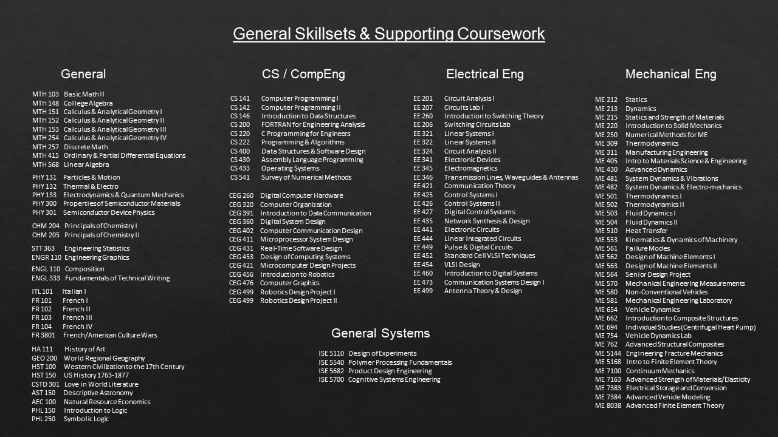

Slide 4
What are the skills employers want ?
The 10 Skills Employers Most Want in New Grads – Ranked
1. Ability to work in a team structure
2. Ability to make decisions and solve problems (tie)
3. Ability to communicate verbally with people inside and outside an organization
4. Ability to plan, organize and prioritize work
5. Ability to obtain and process information
6. Ability to analyze quantitative data
7. Technical knowledge related to the job
8. Proficiency with computer software programs
9. Ability to create and/or edit written reports
10. Ability to sell and influence others
Forbes Magazine

Slide 5
Special Needs Policy
If you have any special needs related to your participation in this course, including identified visual impairment, hearing impairment, physical impairment communication disorder, and/or specific learning disability that may influence your performance in this course, you should meet with the instructor to arrange for reasonable provisions to ensure an equitable opportunity to meet all the requirements.
Accommodations require prior approval by Disability Services.
Please visit http://www.uc.edu/aess/disability.html for more information

Slide 6
Project Overview
Problem
“Develop a hardware device that can detect open parking spaces”

Slide 7
Project Overview
Fundamentals
Teaming
Project Mangement
Electrical Engineering
Mechanical Engineering
Software Engineering

Slide 8
Project Overview
Fundamentals

